Slide 1



























E-Mobility: Role in Climate change mitigation in a balanced Avoid, Shift, Improve Scenario
Oliver Lah
Wuppertal Institute for Climate, Environment and Energy
www.urban-mobility-solutions.eu

Slide 2
Content
Transport and climate change
Electric vehicles around the world
Pathways for low-carbon mobility
E-mobility in the context of sustainable urban mobility
Different forms of e-mobility

Slide 3
Transport and climate change

Slide 4





The challenge ahead
CO₂ emissions are likely to double by 2050 if current trends persist

Slide 5
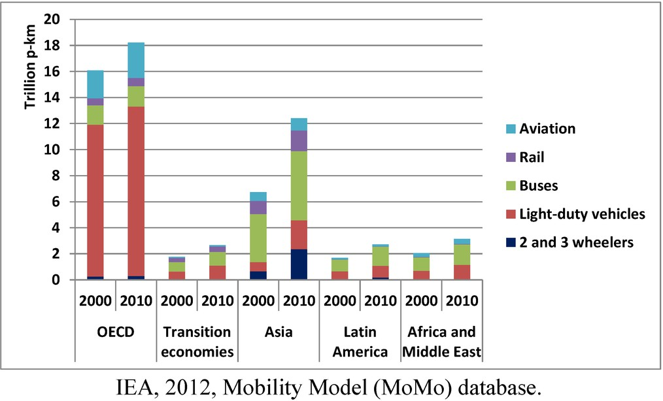
Transport in different parts of the world
Transport currently accounts for 21% of global energy related greenhouse gas emissions – the majority is still in OECD countries, but emerging countries are catching up
Modal distribution of total motorized passenger transport by region in 2000 and 2010.

Slide 6
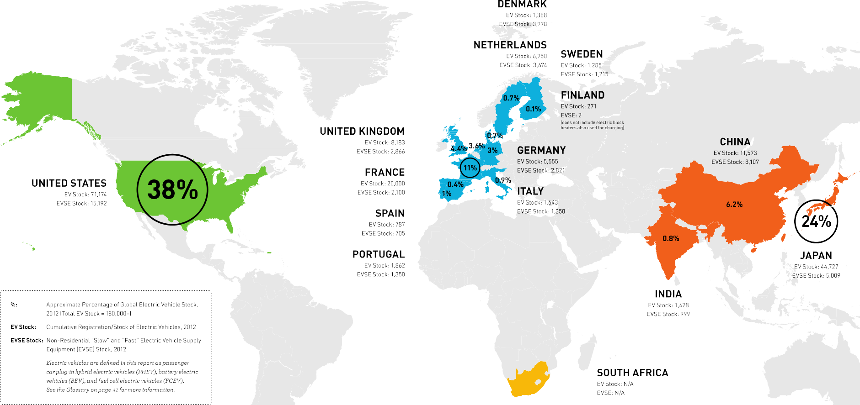
180.000+ EVs on the road...

Slide 7
...which make up 0.02% of the world‘s vehicles fleet

Slide 8
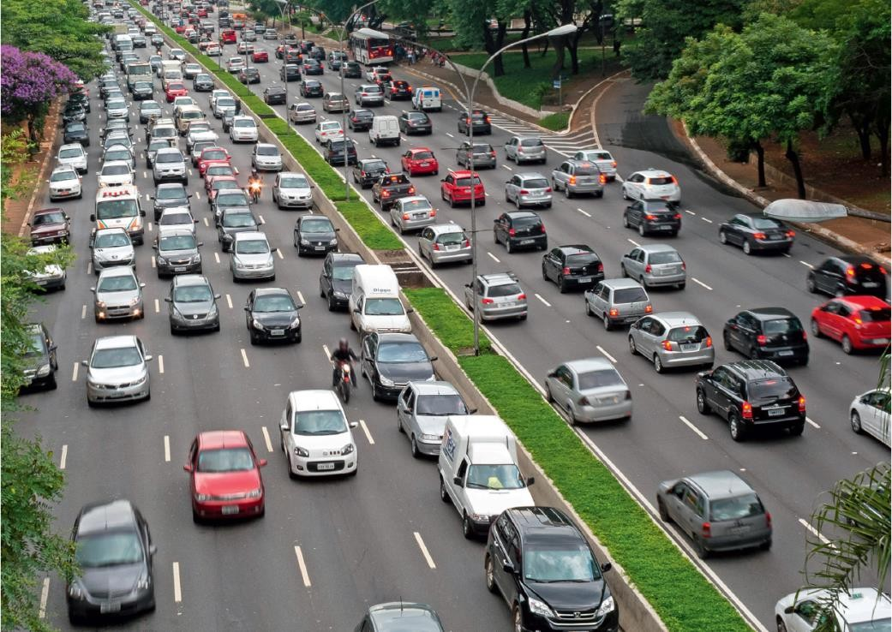
The world before e-mobility....

Slide 9
...the world after e-mobility.

Slide 10
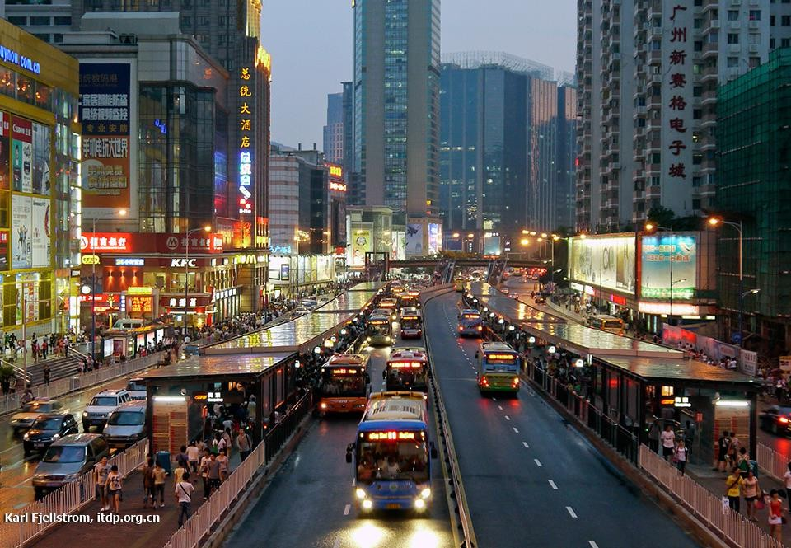
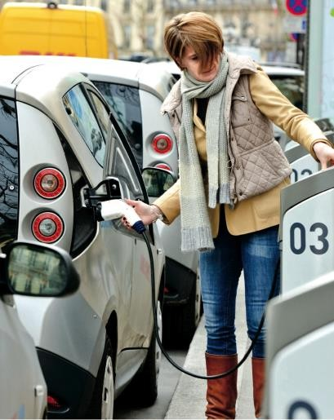
Pathways for Transport
E-mobility as part of a balanced sustainable urban mobility concept
Avoid: reduce travel activity or reduce
growth in activity
Shift: change travel structure through shifts to different modes of travel
Improve: lower vehicle energy intensity and reduce fuel carbon intensity

Slide 11
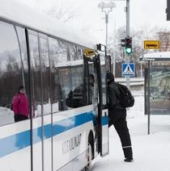
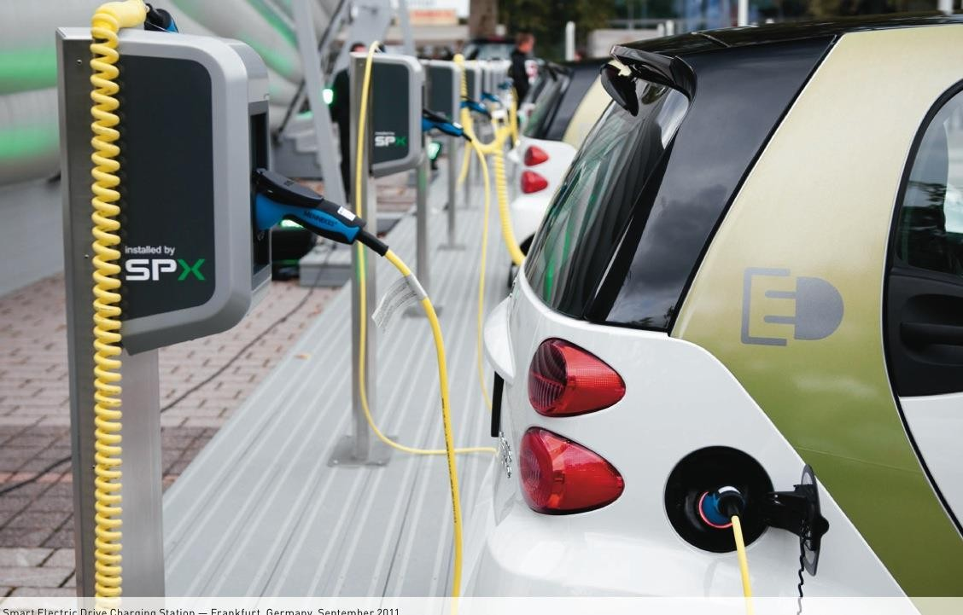
Pathways for Transport
Potential of an integrated
approach:
higher level of socio-economic and cost effectiveness
co-benefits, such as air quality, traffic congestion, safety and overall societal mobility

Slide 12
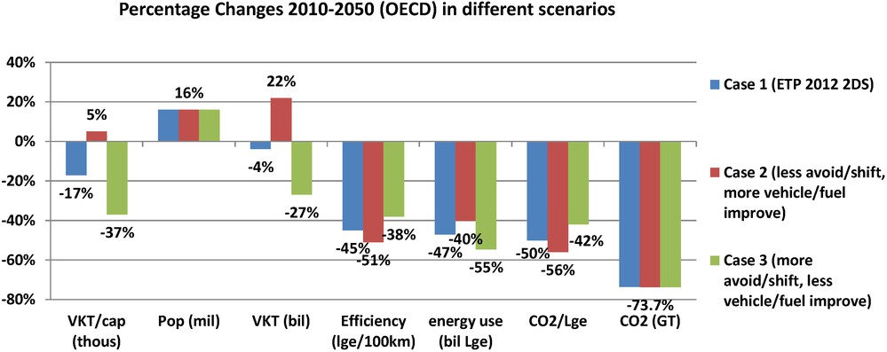
Pathways for Transport
Regional Differences: OECD countries
Light vehicle fleet scenarios until 2050 in OECD countries

Slide 13
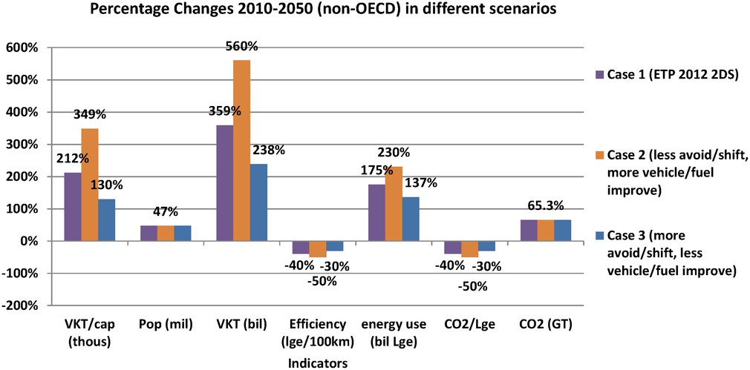
Pathways for Transport
Regional Differences: non OECD countries
Light vehicle fleet scenarios until 2050 in non-OECD countries
(Fulton, Lah, Cuenot 2013)

Slide 14

New technology light-duty vehicle (LDV) sales
New technology light-duty vehicle (LDV) sales in 2-degree scenario combined
(battery electric vehicle (BEV) + plug-in hybrid vehicle (PHEV) + Fuel cell).
(Fulton, Lah, Cuenot 2013)

Slide 15


Sales share in three cases
(Fulton, Lah, Cuenot 2013)

Slide 16
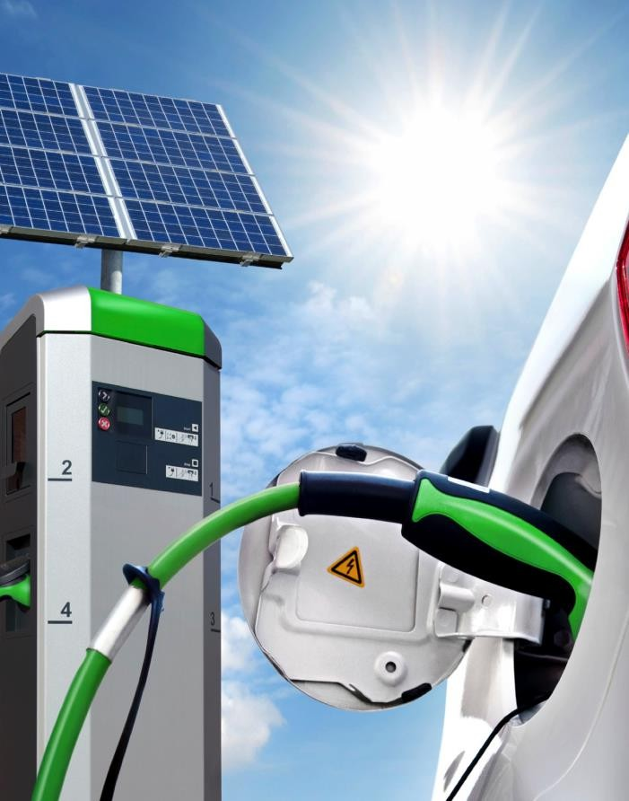
Key factors for low-carbon e-mobility
Currently the well-to-wheel carbon intensity varies greatly among countries/regions.
When electricity and hydrogen in plug-in and fuel cell vehicles reach a substantial market share, they can serve strongly to decrease the average LDV fuel carbon intensity after 2035
Source: IEA

Slide 17
Pathways for Transport
250,0
200,0
Gasoline/ biofuels
CO2 / MJ
150,0
Electricity
100,0
H2
50,0
Weighted average
0,0
2010 2015 2020 2025 2030 2035 2040 2045 2050
LDV Fuel Carbon Intensity in 2DS
(Fulton, Lah, Cuenot 2013)

Slide 18
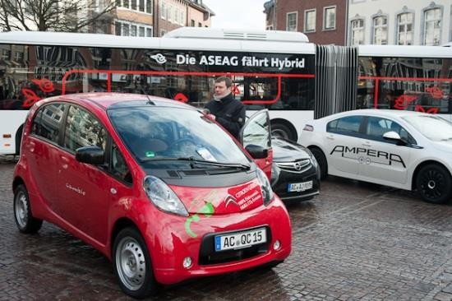
Different options for e-mobility
E-mobility for car- sharing and public transport fleets
Public procurement as enabler
Direct control or indirect through contracts
Leadership role and test-bed for good practice
Source: Eltis

Slide 19

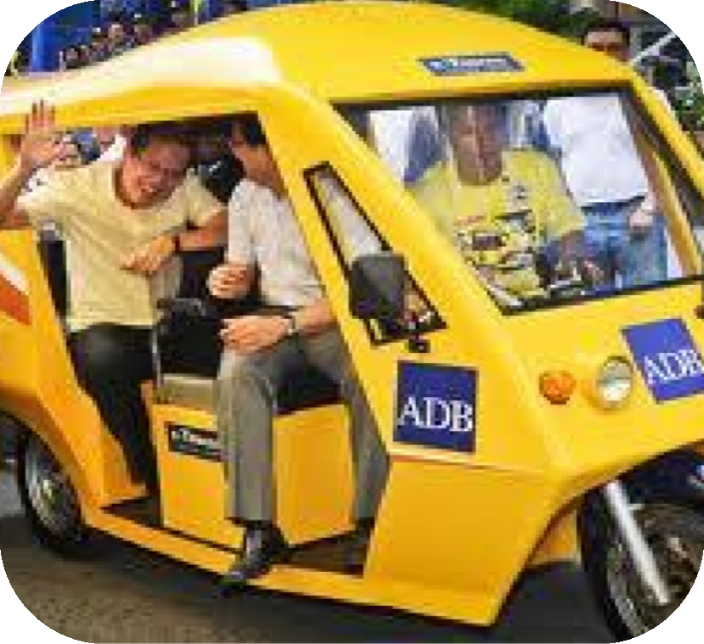
Different options for e-mobility
Low carbon taxi fleets
E-tricycles in Manila (locally produced e-trikes)
Electric taxis in Shenzhen (entire taxi fleet to be electric by 2016)
Source: ADB 2011

Slide 20

Different options for e-mobility
Electric two-wheelers
Rapid growth of electric two-wheelers in particular in China driven by regulation
At the peak there were over 150 million electric two- wheelers on the road in China
Growing safety issues: the Black Death”
Now electric scooters are going to be banned in many cities for saftey reasons
Source: ADB 2011

Slide 21
Different options for e-mobility
Basic requirements
Standardised charging
infrastructure
Battery costs (currently
$485/kW/h) and materials
Battery replacement and recycing
Source: Eltis

Slide 22
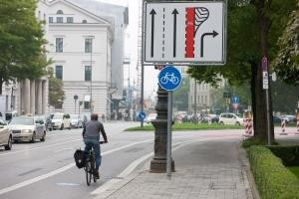
A balanced approach is vital for success
Stronger shifts to low-carbon modes, such as public transport and non-motorized trasport would require less effort with regard to low- carbon technology and fuel uptake
If travel demand is less managed stronger efficiency improvements and fuel and technology switch is required
A balanced approach inludes: reduction of travel demand and foster modal shifts (Avoid/Shift) AND improvements in vehicle technology and fuels (Improve)
Source: Eltis

Slide 23
oliver.lah@wupperinst.org www.urban-mobility-solutions.eu

